Slide 1
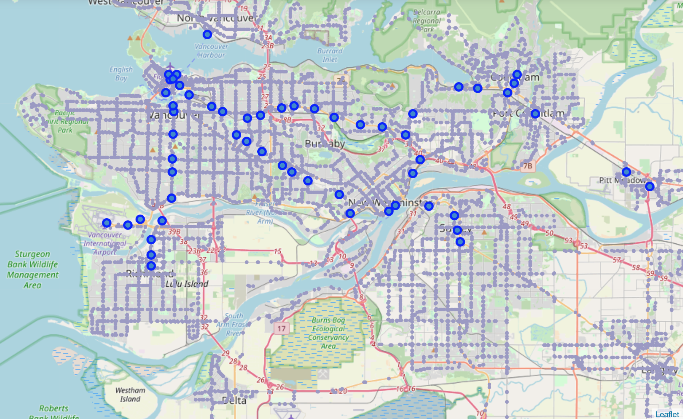
Legend
Rapid Transit Station
Bus Stop

Slide 2
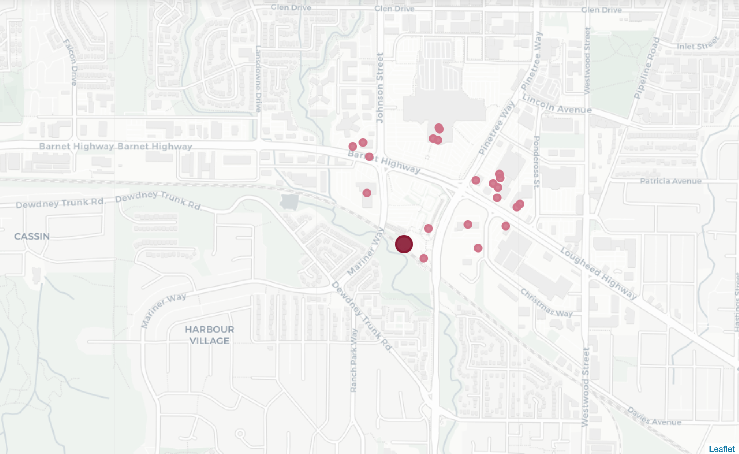
Legend
Rapid Transit Station
Foursquare Venue
400 m
Catchment Area

Slide 3
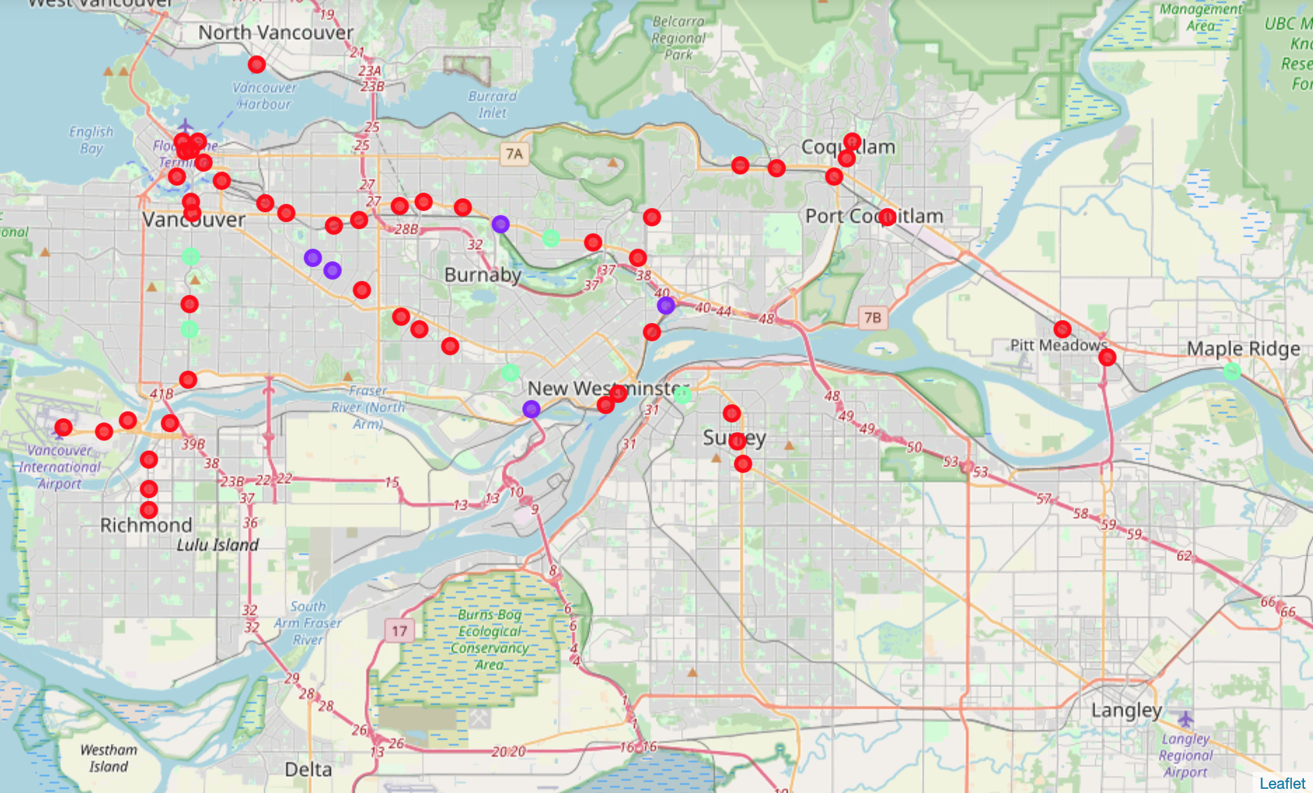
Legend
Cluster 1
Cluster 2
Cluster 3

